Slide 1
mathematical optimization
CO2- Integer programming – GoMoRy Cut plane method

Slide 2





AIM OF THE SESSION
To familiarize students with the method of solving ILP using Gomory cut plane method.
INSTRUCTIONAL OBJECTIVES
This Session is designed to:
Introduce Gomory Cut plane method
Discuss methods to solve ILP using Gomory Cut plane method
LEARNING OUTCOMES
At the end of this session, the students should be able to:
Understand the solution for an ILP using Gomory Cut plane method

Slide 3
THE CUTTING–PLANE ALGORITHM
An Algorithm for solving Pure integer and mixed integer programming problems was developed by R. E. Gomory.
Relax the integer requirements.
Solve the resulting LP problem using Simplex Method.
If all the basic variables have integer values, Optimality of the Integer programming problem is reached. So go step 7; otherwise go to step 4.
Examine the constraints corresponding to the current optimal solution. For each Basic Variable with non-integer solution in the current optimal table, find the fractional part, f_{i} , Therefore, b_{i} = [b_{i}] + f_{i}, where [b_{i}] is the integer part of b_{i}, and f_{i} is the positive fractional part of b_{i}.
Choose the largest fraction among various f_{i} ; i.e., Max (f_{i}). Treat the constraint corresponding to the maximum fraction as the source row (equation). Based on the source equation, develop an additional constraint (Gomory’s constraint / fractional cut) as shown:
  –f_{i} = S_{i} – Summation ((f_{i})(Non–Basic Variable))
Add the fractional cut as the last row in the latest optimal table and proceed further using dual simplex method, and find the new optimum solution. If the new optimum solution is integer then go to step 7; otherwise go to step 4.
7. Print the integer solution [X’s and Z – Values]
19

Slide 4
THE CUTTING–PLANE ALGORITHM
EXAMPLE:
Max. Z = 5X₁ + 8X₂
Subject to:
X₁ + 2X₂ ≤ 8
4X₁ + X₂ ≤ 10
X₁, X₂ ≥ 0 and integers
Standard Form:
Max. Z = 5X₁ + 8X₂ + 0S₁ +0S₂
Subject to:
X₁ + 2X₂ + S₁ = 8
4X₁ + X₂ + S₂ = 10
X₁, X₂, S₁, and S₂ ≥ 0 and integers

Slide 5
THE CUTTING–PLANE ALGORITHM (Cont…)
Max. Z = 5X₁ + 8X₂ + 0S₁ +0S₂
Subject to:
X₁ +2X₂ + S₁ +0S₂ =8
4X₁ + X₂ +0S₁ + S₂ = 10
X₁, X₂, S₁, and S₂ ≥ 0 and integers
Initial Simplex Table:
Contribution Per Unit C_{j} |  | 5 | 8 | 0 | 0
^{C}Bi | Basic Variables (B) | X₁ | X₂ | S₁ | S₂ | bj (solution) | Ratio
0 | S₁ | 1 | 2 | 1 | 0 | 8 | 8/2 = 4*
0 | S₂ | 4 | 1 | 0 | 1 | 10 | 10/1 = 10
Total Profit (Z_{j}) |  | 0 | 0 | 0 | 0 | 0
Net Contribution (C_{j} – Z_{j}) |  | 5 | 8* | 0 | 0

Slide 6
THE CUTTING–PLANE ALGORITHM (Cont…)
Initial Table:
Contribution Per Unit C_{j} |  | 5 | 8 | 0 | 0
^{C}Bi | Basic Variables (B) | X₁ | X₂ | S₁ | S₂ | SOLUTION | Ratio
0 | S₁ | 1 | 2 | 1 | 0 | 8 | 8/2 = 4*
0 | S₂ | 4 | 1 | 0 | 1 | 10 | 10/1 = 10
Total Profit (Z_{j}) |  | 0 | 0 | 0 | 0 | 0
Net Contribution (C_{j} – Z_{j}) |  | 5 | 8* | 0 | 0
Iteration # 1:
Contribution Per Unit C_{j} |  | 5 | 8 | 0 | 0
^{C}Bi | Basic Variables (B) | X₁ | X₂ | S₁ | S₂ | SOLUTION | Ratio
8 | X₂ | 1/2 | 1 | 1/2 | 0 | 4 | 8
0 | S₂ | 7/2 | 0 | -1/2 | 1 | 6 | 12/7*
Total Profit (Z_{j}) |  | 4 | 8 | 4 | 0 | 32
Net Contribution (C_{j} – Z_{j}) |  | 1* | 0 | -4 | 0

Slide 7
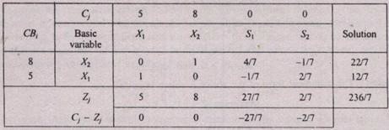
THE CUTTING–PLANE ALGORITHM
(Cont…)
Iteration # 2:
All the Values of (C_{j} – Z_{j}) ≤ 0; So, the current solution is optimal for LP.
X₁ = 12/7, X₂ = 22/7 and Z = 236/7
However, the values of the decision variables X₁ & X₂ are not integers, so, the solution is not optimum for Integer Programming.

Slide 8
THE CUTTING–PLANE ALGORITHM
(Cont…)
All the Values of (C_{j} – Z_{j}) ≤ 0; So, the current solution is optimal for linear programming.
X₁ = 12/7, X₂ = 22/7 and Z = 236/7
STEP #4: Summary of Integer & Fractional Parts
Basic Variable in the above Optimal table | b_{i} | [b_{i}] + f_{i}
X₁ | 12/7 | 1 | + | (5/7)
X₂ | 22/7 | 3 | + | (1/7)
Maximum fraction value

Slide 9
THE CUTTING–PLANE ALGORITHM (Cont…)
STEP #5: The fractional part, f₁, is the maximum. So, Select the Row “X₁” as the Source row for developing first cut.
    X₁ – 1/7S₁ + 2/7S₂ = 12/7
    (1+0)X₁ + (-1+6/7)S₁ + (0+2/7)S₂ = 1+5/7
    0 + 6/7 + 2/7 >= 5/7
    0X₁ + 6/7S₁ + 2/7S₂ = 5/7 + S₃
    –5/7 = S₃ – 6/7S₁ – 2/7S₂
This is the fractional cut proposed by Gomory :
–f_{i} = S_{i} – Summation ((f_{i})(Non–Basic Variable))

Slide 10
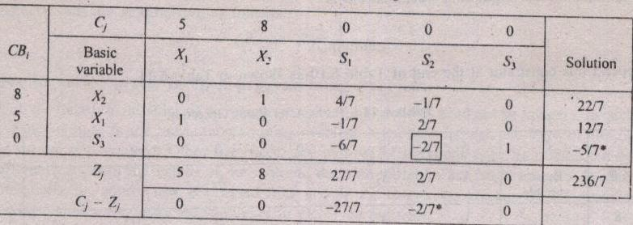
THE CUTTING–PLANE ALGORITHM (Cont…)
STEP # 5: The fractional cut is:
–f_{i} = S_{i} – Summation ((f_{i})(Non–Basic Variable))
–5/7 = S₃ – 6/7S₁ – 2/7S₂ ==> 0X1 +0X2 –(6/7)S1 -(2/7)S2 +1S3 = -5/7
STEP # 6: This cut is added to the table which we get in Iteration # 2 (Optimal Table Solution for Linear Programming), and further solved using dual simplex method.

Slide 11
THE CUTTING–PLANE ALGORITHM (Cont…)
Only the third row (Containing S₃) has a negative solution value. Therefore, S₃ (LEAVING Variable) leaves the basis.
For ENTERING Variable;
Ratio = (C_{j} – Z_{j}) / (Pivot Row <0)
The smallest ratio is “1” and the corresponding variable is “S₂”. So, the variable “S₂” enters the basis.

Slide 12
THE CUTTING–PLANE ALGORITHM (Cont…)
Contribution Per Unit C_{j} |  | 5 | 8 | 0 | 0 | 0
^{C}Bi | Basic Variables (B) | X₁ | X₂ | S₁ | S₂ | S₃ | SOLUTION
8 | X₂ | 0 | 1 | 1 | 0 | - 1/2 | 7/2
5 | X₁ | 1 | 0 | -1 | 0 | 1 | 1
0 | S₂ | 0 | 0 | 3 | 1 | -7/2 | 5/2
Total Profit (Z_{j}) |  | 5 | 8 | 3 | 0 | 1 | 33
Net Contribution (C_{j} – Z_{j}) |  | 0 | 0 | -3 | 0 | -1
The Solution is still non-integer. So, develop a fractional cut. The Basic variables X₂ and S₂ are not integers.
25

Slide 13
THE CUTTING–PLANE ALGORITHM (Cont…)
Contribution Per Unit C_{j} |  | 5 | 8 | 0 | 0 | 0
^{C}Bi | Basic Variables (B) | X₁ | X₂ | S₁ | S₂ | S₃ | SOLUTION
8 | X₂ | 0 | 1 | 1 | 0 | - 1/2 | 7/2
5 | X₁ | 1 | 0 | -1 | 0 | 1 | 1
0 | S₂ | 0 | 0 | 3 | 1 | -7/2 | 5/2
Total Profit (Z_{j}) |  | 5 | 8 | 3 | 0 | 1 | 33
Net Contribution (C_{j} – Z_{j}) |  | 0 | 0 | -3 | 0 | -1
STEP #4:
Summary of Integer & Fractional Parts
Basic Variable in the above Optimal table | b_{i} | [b_{i}] + f_{i}
X₂ | 7/2 | 3 | + | 1/2
S₂ | 5/2 | 2 | + | 1/2
STEP # 5: Here, the fractional parts are the same for X₂ & S₂. But, we preferred the fractional part of the X₂. So, Select the Row “X₂” as the Source row for developing cut
25

Slide 14
THE CUTTING–PLANE ALGORITHM (Cont…)
Contribution Per Unit C_{j} |  | 5 | 8 | 0 | 0 | 0
^{C}Bi | Basic Variables (B) | X₁ | X₂ | S₁ | S₂ | S₃ | SOLUTION
8 | X₂ | 0 | 1 | 1 | 0 | - 1/2 | 7/2
5 | X₁ | 1 | 0 | -1 | 0 | 1 | 1
0 | S₂ | 0 | 0 | 3 | 1 | -7/2 | 5/2
Total Profit (Z_{j}) |  | 5 | 8 | 3 | 0 | 1 | 33
Net Contribution (C_{j} – Z_{j}) |  | 0 | 0 | -3 | 0 | -1
STEP # 5: Here, the fractional parts are the same for X₂ & S₂. But, we preferred the fractional part of the X₂. So, Select the Row “X₂” as the Source row for developing cut
7/2 = X₂ + S₁ – 1/2S₃ → (3+ 1/2) = (1+0)X₁ + (1+0)S₁ + (–1+1/2)S₃
The Corresponding fractional cut is:
–f_{i} = S_{i} – Summation ((f_{i})(Non–Basic Variable))
–1/2 = S₄ – 1/2S₃

Slide 15
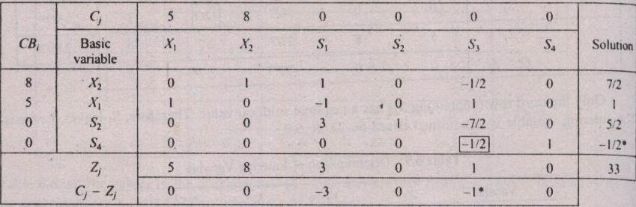
THE CUTTING–PLANE ALGORITHM (Cont…)
–1/2 = S₄ – 1/2S₃
STEP # 6: This cut is added to the simplex table, and further solved using dual simplex method.
For ENTERING Variable;
Ratio = (C_{j} – Z_{j}) / (Pivot Row <0)
The smallest positive ratio is “2” and the corresponding variable is “S₃”. So, the variable “S₃” enters the basis.

Slide 16
THE CUTTING–PLANE ALGORITHM (Cont…)
Contribution Per Unit C_{j} |  | 5 | 8 | 0 | 0 | 0 | 0
^{C}Bi | Basic Variables (B) | X₁ | X₂ | S₁ | S₂ | S₃ | S₄ | SOLUTION
8 | X₂ | 0 | 1 | 1 | 0 | 0 | -1 | 4
5 | X₁ | 1 | 0 | -1 | 0 | 0 | 2 | 0
0 | S₂ | 0 | 0 | 3 | 1 | 0 | -7 | 6
0 | S₃ | 0 | 0 | 0 | 0 | 1 | -2 | 1
Total Profit (Z_{j}) |  | 5 | 8 | 3 | 0 | 0 | 2 | 32
Net Contribution (C_{j} – Z_{j}) |  | 0 | 0 | -3 | 0 | 0 | -2
So, The values of all the basic variables are integers. So, the optimality is reached
and the corresponding results are summarized as follows:
X₁ = 0, X₂ = 4 and Z (Optimum) = 32

Slide 17
THE CUTTING–PLANE ALGORITHM
An Algorithm for solving Pure integer and mixed integer programming problems was developed by R. E. Gomory.
Relax the integer requirements.
Solve the resulting LP problem using Simplex Method.
If all the basic variables have integer values, Optimality of the Integer programming problem is reached. So go step 7; otherwise go to step 4.
Examine the constraints corresponding to the current optimal solution. For each Basic Variable with non-integer solution in the current optimal table, find the fractional part, f_{i} , Therefore, b_{i} = [b_{i}] + f_{i}, where [b_{i}] is the integer part of b_{i}, and f_{i} is the positive fractional part of b_{i}.
Choose the largest fraction among various f_{i} ; i.e., Max (f_{i}). Treat the constraint corresponding to the maximum fraction as the source row (equation). Based on the source equation, develop an additional constraint (Gomory’s constraint / fractional cut) as shown:
  –f_{i} = S_{i} – Summation ((f_{i})(Non–Basic Variable))
Add the fractional cut as the last row in the latest optimal table and proceed further using dual simplex method, and find the new optimum solution. If the new optimum solution is integer then go to step 7; otherwise go to step 4.
7. Print the integer solution [X’s and Z – Values]
19

